Slide 1
Programming for problem solving (PPS)

Slide 2
COURSE OBJECTIVES:
To learn the fundamentals of computers.
To understand the various steps in program development.
To learn the syntax and semantics of C programming language.
To learn the usage of structured programming approach in solving problems.

Slide 3
BOOKS
Text Books:
Byron Gottfried, Schaum’s Outline of Programming with C, McGraw-Hill
B.A. Forouzan and R.F. Gilberg C Programming and Data Structures, Cengage Learning, (3rd Edition)
Reference Books:
Brian W. Kernighan and Dennis M. Ritchie, The C Programming Language, Prentice Hall of India
R.G. Dromey, How to solve it by Computer, Pearson (16th Impression)
Programming in C, Stephen G. Kochan, Fourth Edition, Pearson Education.
Herbert Schildt, C: The Complete Reference, Mc Graw Hill, 4th

Slide 4
UNIT-1
Objectives
At the end of the unit student will
Understand about introductory concepts about computer
Understand about Algorithms , flowchart and Pseudo code
Understand the basic structure of a program in C .
Obtain a preliminary idea of the keywords in C.
Learn the data types, variables, constants,
4

Slide 5
UNIT-1
Understand operators, and expressions in C.
Understand and grasp the precedence and associativity rules of operators in C.
Get acquainted with the rules of type conversions in C.
Understand that C provides a set of input and output functions
Learn to use the formatted input and output functions scanf() and printf() for handling multiple input and output.
5

Slide 6
UNIT-1
L-1 :
1. Introduction to Computers
2. Computer Characteristics
3. Modes of Operation

Slide 7
Introduction to Computer
Computer:
A Computer is an electronic device that takes data and instructions as an input from the user, process data, and provides useful information known as output.
OR
It is a high speed electronic device that accepts and stores input data and instructions, process the data and produces the desired output.
Charles Babbage (16 December 1791 –18 October 1871) was an English polymath. He was invented first analytical computer in year 1811.
He is known as father of computers.
7

Slide 8
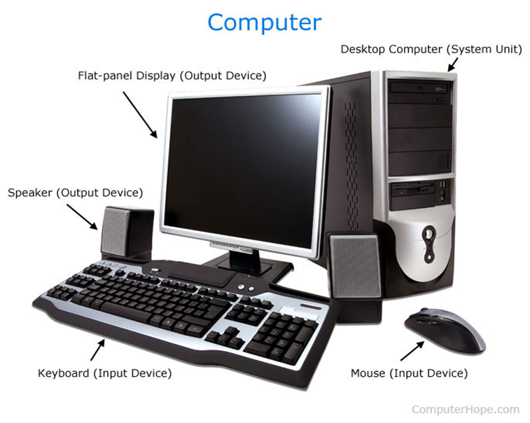
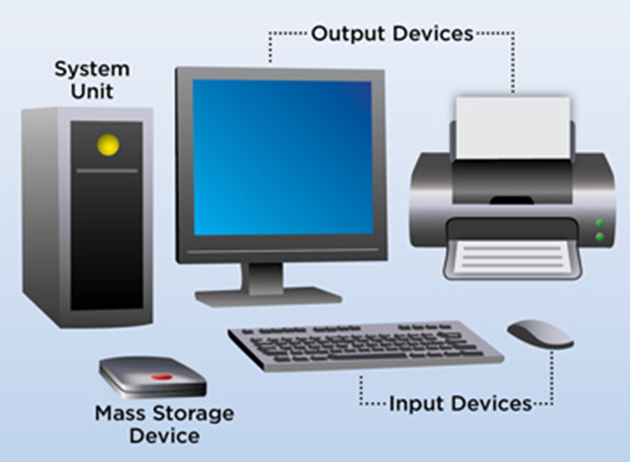
Introduction to Computer

Slide 9
Introduction to Computer
The term computer is derived from the Latin term “computare”, this means to calculate or programmable machine.
Computer cannot do anything without a Program.
It performs the following three operations in sequence.
It receives data & instructions from the input device.
Processes the data as per instructions.
Provides the result (output) in a desired form.
9

Slide 10
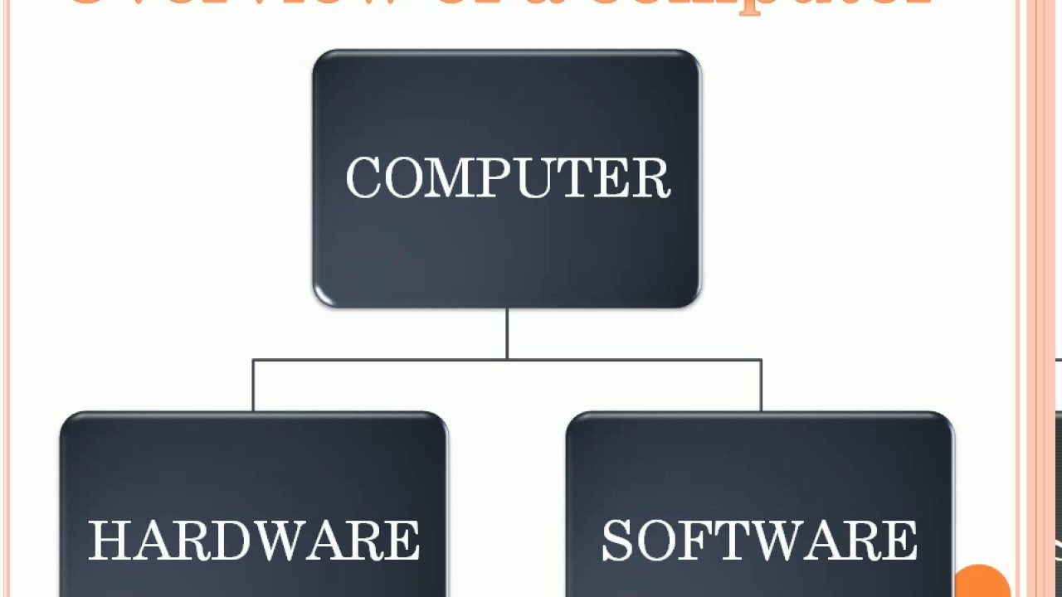
Computer Systems: Introduction to components of a Computer System:

Slide 11
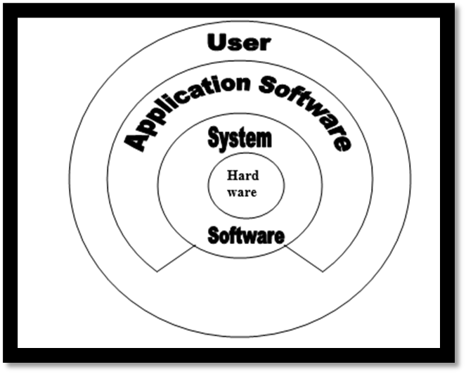
It is made of major two components. 1) Software 2) Hardware.

Slide 12
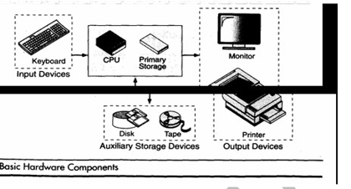
Computer Hardware
The hardware component of the computer system consists of five parts: input devices, central processing unit (CPU) , primary storage, output devices, and auxiliary storage devices.

Slide 13
Computer Software
Computer software is divided in to two broad categories: system software and application software .System software manages the computer resources .It provides the interface between the hardware and the users. Application software, on the other hand is directly responsible for helping users solve their problems.

Slide 14
1.System Software:
Operating system:provides services such as a user interface, file and database access, and interfaces to communication systems such as Internet protocols
System support :sort programs and disk format programs.
System development: includes the language translators , debugging tools
2. Application software is broken in to two classes :
General-purpose software :eg word processor ,DBMS etc
Application- specific software

Slide 15
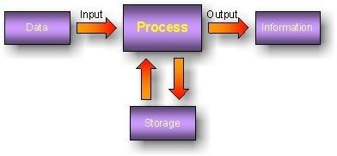
Introduction to Computer
Fig. 1 Basic block diagram of a computer
There are four main building blocks in a computers
Input Unit
Processor
Memory
Output Unit
15

Slide 16
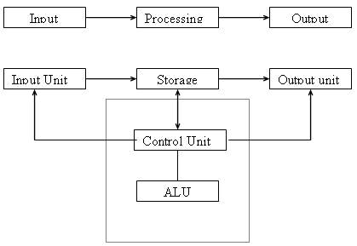
CPU Block Diagram

Slide 17
Input Unit
Computers need to receive data and instruction in order to solve
any problem.
Therefore we need to input the data and instructions into the computers.
The input unit consists of one or more input devices.
Keyboard is the one of the most commonly used input device.
Other commonly used input devices are the
mouse, pen drive, magnetic tape, SSD(Solid state Drive) etc.
All the input devices perform the following functions.
Accept the data and instructions from the outside world.
Convert it to a form that the computer can understand.
Supply the converted data to the computer system for further
processing.

Slide 18
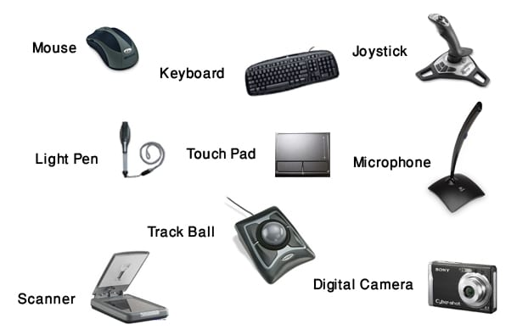
Input Unit

Slide 19
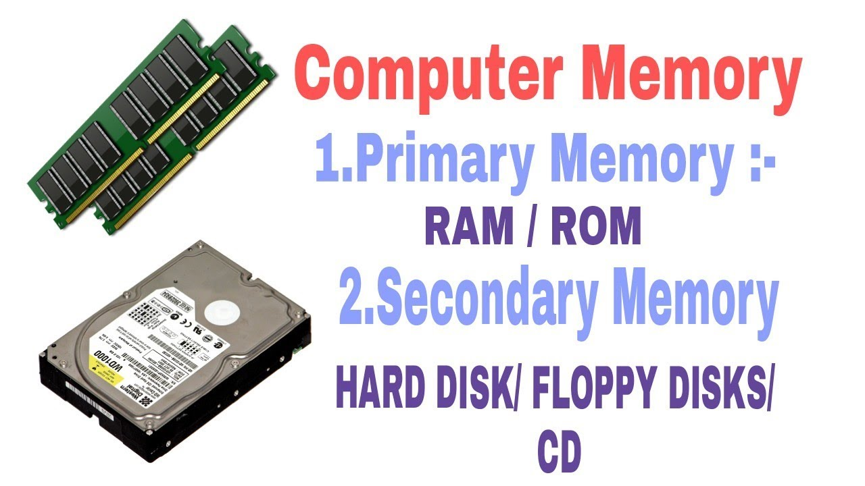
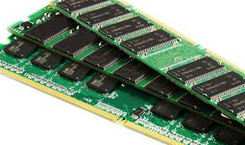
Storage Unit

Slide 20
Storage Unit
The storage unit of the computer holds data and instructions that are entered through the input unit, before they are processed. Storages are divided into two types:
Primary Storage: Stores data and is very fast. This memory is generally used to hold the program being currently executed in the computer, the data being received from the input unit, the intermediate and final results of the program. The primary memory is temporary in nature. The data is lost, when the computer is switched off. Ex: DDR4 RAM (Volatile).
Secondary Storage: Secondary storage is used like an archive. It stores several programs, documents, data bases etc. The secondary memory is slower and cheaper than the primary memory. Some of the commonly used secondary memory devices are Hard disk, CD, etc., (Non-Volatitle)

Slide 21
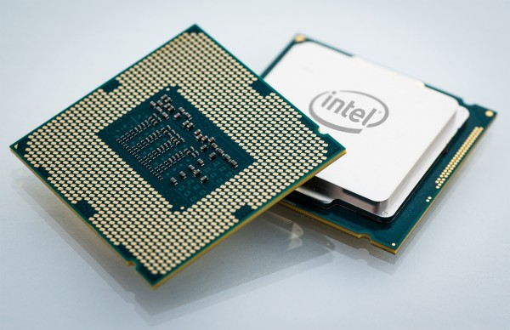
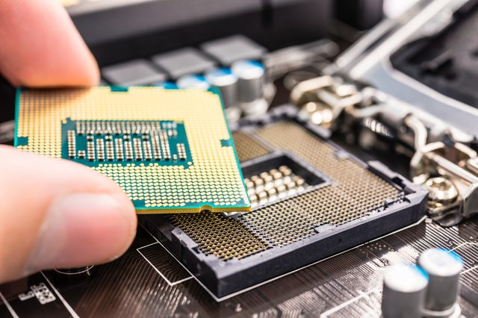
CPU(Center Processing Unit)

Slide 22
CPU(Central Processing Unit)
The control unit and ALU of the computer are together known as the Central Processing Unit (CPU).
1. Control Unit: It is responsible for directing and coordinating most of the computer system activities. It does not execute instructions by itself. It tells other parts of the computer system what to do. It determines the movement of electronic signals between the main memory and arithmetic logic unit as well as the control signals between the CPU and input/output devices.
2. Arithmetic logic Unit: ALU performs all the arithmetic and logical functions i.e. addition, subtraction, multiplication, division and certain comparisons. These comparisons include greater than, less than, equals to etc. The ALU controls the speed of calculations.
3. Registers: It is a special temporary storage location within the CPU.
4. Bus: The term Bus refers to an electrical pathway through which bits are transmitted between the various computer components.

Slide 23
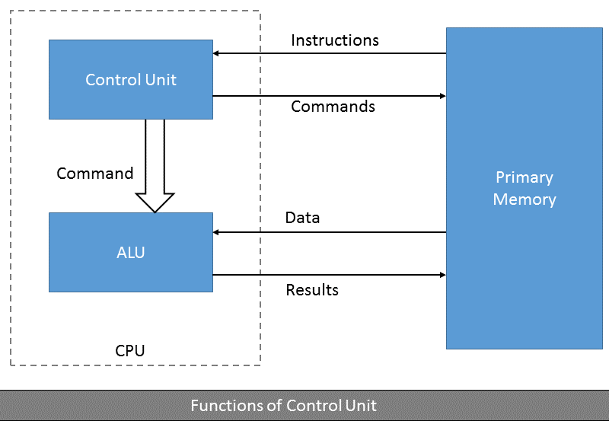
Control Unit
It controls all other units in the computer. The control unit instructs the input unit, where to store the data after receiving it from the user. It controls the flow of data and instructions from the storage unit to ALU. It also controls the flow of results from the ALU to the storage unit.

Slide 24
Arithmetic Logical Unit
All calculations are performed in the Arithmetic Logic Unit (ALU) of the computer. It also does comparison and takes decision. The ALU can perform basic operations such as addition, subtraction, multiplication, division, etc and does logic operations viz, >, <, =, ‘etc.
Whenever calculations are required, the control unit transfers the data from storage unit to ALU once the computations are done, the results are transferred to the storage unit by the control unit and then it is send to the output unit for displaying results.

Slide 25
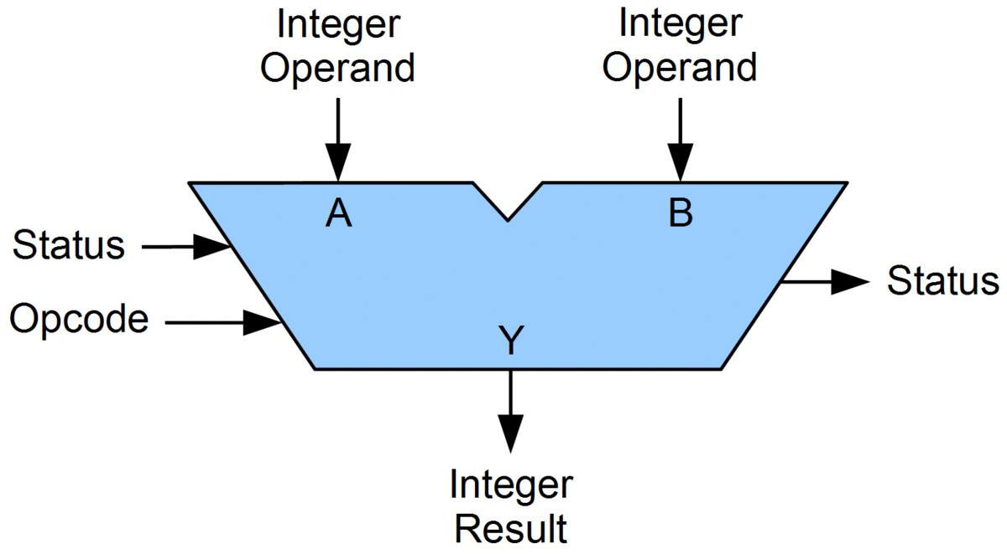
Arithmetic Logical Unit

Slide 26

Output Unit
The output unit of a computer provides the information and results of a computation to outside world. Printers, Visual Display Unit (VDU) are the commonly used output devices.

Slide 27
What is an Operating System?
An operating system (OS) is system software that manages computer hardware and software resources and provides common services for computer programs. It acts as an interface between computer and user.
The low-level software that supports a computer's basic functions, such as scheduling tasks and controlling peripherals.
Types of Operating Systems: MS-DOS, Windows 98, Windows 2000, Windows XP, Linux, Unix, MAC-OS etc.
Different categories of OS: Time-sharing, Batch OS, Distributed OS, Network OS, Real Time OS

Slide 28
What is a Compiler?
A compiler is a special program that processes statements written in a particular programming language and turns them into machine language or "code" that a computer's processor uses.
Each language(JAVA, C, C++, C# etc.) has its own compiler.
Jobs of a compiler:
Check for all Syntax errors in program.
Compile the complete program into a machine dependent Low level Language called as binary code(0’s and 1’s).
It is slow compared to Interpreters.

Slide 29
Execution process of C program
Source Program
Compiler
Object Program
Linker
Executable Program
Run the program

Slide 30
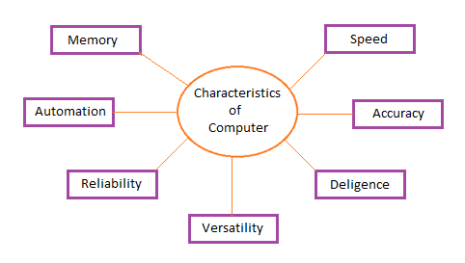
Computer characteristics:

Slide 31
Computer Characteristics
Speed:
A powerful computer is capable of performing about 3-4 million simple instructions per second.
Accuracy:
Computers perform all jobs with 100% accuracy provided that correct input has been given.
Diligence:
computers are highly consistent. They do not suffer from human traits of boredom and tiredness resulting in lack of concentration. Computers, therefore, are better than human beings in performing voluminous and repetitive jobs.
versatility:
The presence of computers can be seen in almost every sphere – Railway/Air reservation, Banks, Hotels, Weather forecasting and many more.
storage capacity. Today’s computers can store large volumes of data
31

Slide 32
Modes of operations.
Following are the various types of computing environments...
Personal Computing Environment
Time Sharing Computing Environment
Client Server Computing Environment
Distributed Computing Environment
32

Slide 33
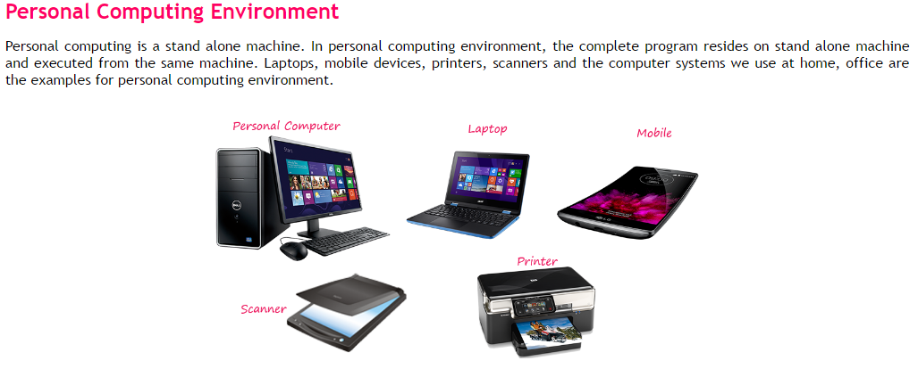
Modes of operations.
33

Slide 34
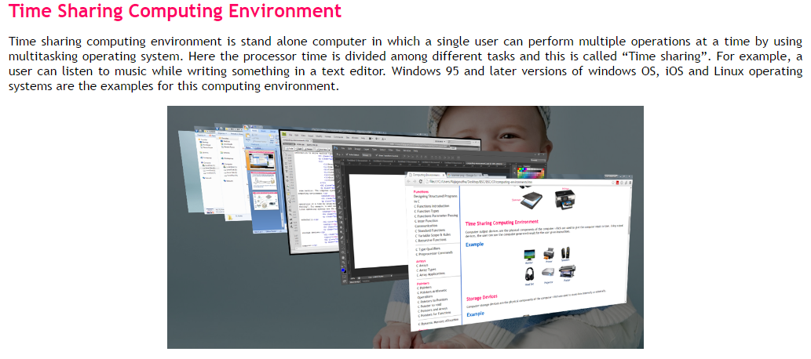
Modes of operations.
34

Slide 35
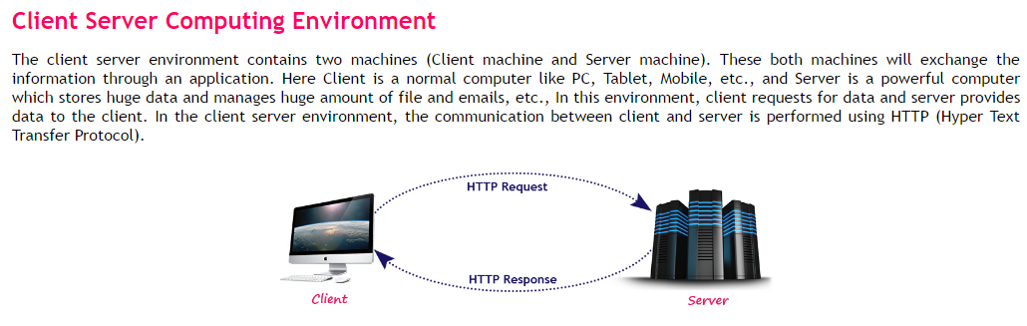
Modes of operations.
35

Slide 36
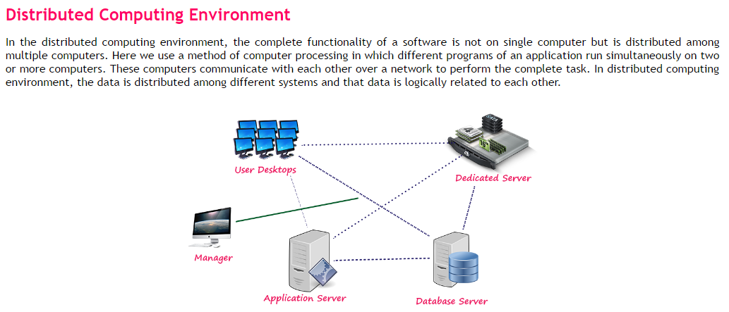
Modes of operations.
36

Slide 37
UNIT-1
L2:
1 Types of Programming Languages
2. Introduction to C
3. Algorithms & Flowcharts
Pseudocode.
4. Program Development Steps.
5. Types of Errors

Slide 38
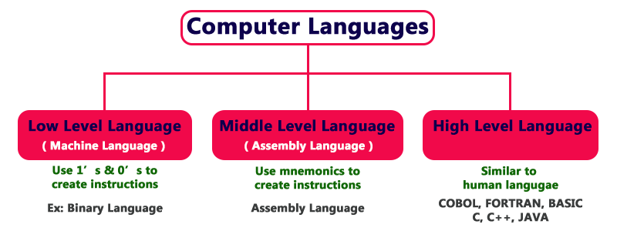
Types of programming Languages.
A programming language: The language used in the communication of computer instructions is known as the programming language.
There are three levels of programming languages are .

Slide 39
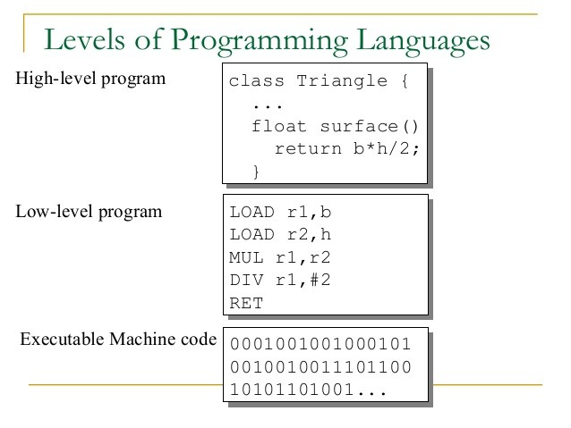
Types of programming Languages
Machine languages ( Low-level Languages)
A language that is directly understood by the computer without any translation is called machine languages. A machine language is string of 0s and 1s.
Advantage :
Execution is very fast since there is no need of conversion
Disadvantage :
Writing and reading programs in machine language is very difficult
Machine instructions are difficult to remember

Slide 40
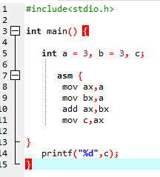
Types of programming Languages
Assembly languages (Symbolic Languages)
Assembly languages are just one level higher than machine language.Assembly language consists of special codes called mnemonics to represent the language instructions instead of 0’s and 1’s. The mnemonic code is also called as operation code or opcode.
For example, ADD, SUB, MUL, JMP, LOAD
Advantage :
Easy to read and writeprograms in assembly language when compared to machine language
Mnemonics are easy to remember
Disadvantage :
Assembly programs are machine dependent
Execution is slow since it needs conversion into machine language
“Assembler” is used to convert
assembly language program into machine language.

Slide 41
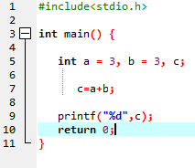
Types of programming Languages
High Level Languages: a high-level language is a computer programming language, designed for a specific job, and is easier to understand. For a computer to understand and run a program created with a high-level language, it must be compiled into machine language.
Ex. BASIC, C, C++, COBOL, FORTRAN, Java, Pascal, Perl, PHP, Python, Ruby and Visual Basic.
Advantage :
i) Machine independence i.e. programs are “Portable” i.e. programs can be moved from one system to another
ii) Easy to learn and understand
iii) Takes less time to write programs
Disadvantage :
High level language programs needs a translator for conversion into machine language
‘Compilers’ (or) ‘Interpreters’ are used for converting high level language program into machine language..

Slide 42
Algorithm
An algorithm is a finite set of step-by-step instructions to solve a problem.
The essential properties of an algorithm are:
Finiteness: The algorithm must always terminate after a finite number of steps.
Definiteness: Each and every instruction should be precise and unambiguous i.e. each and every instruction should be clear and should have only one meaning.
Effectiveness: Each instruction should be performed in finite amount of time.
Input and Output: An algorithm must take zero or more inputs, and produce one or more outputs.
Generality: An algorithm applies to different sets of same input type.

Slide 43
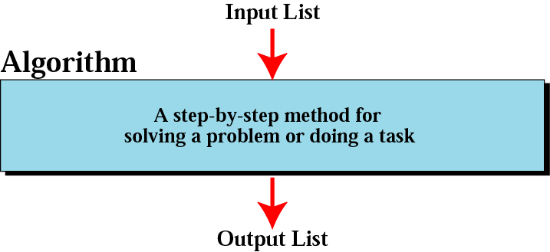
Algorithm
43

Slide 44
Algorithm
Examples:1 Write an algorithm to add two numbers
Step 1: Declare variables num1, num1 and sum
Step 2: Read num1 and num2
Step 3: Add num1 and num1 and assign the result to sum. sum←num1+num2
Step 4: Display sum
2. Example 1: Calculate the Interest of a Bank Deposit
Algorithm:
Step 1: Read amount,
Step 2: Read years,
Step 3: Read rate,
Step 4: Calculate the interest with formula "Interest=Amount*Years*Rate/100
Step 5: Print interest,
More Examples

Slide 45
Pseudo code
Algorithm
It is a simple way of writing programming code in English.
It is a combination of generic syntax and normal English language.
Pseudo code is not actual programming language.
It uses short phrases to write code for programs before actually create it in a specific language.
It helps the programmer understand the basic logic of the program.
Example: To add two numbers and display the result as shown below:
DEFINE: Integer num1, num1, result
READ: Integer num1
READ: Integer num2
SET: result=num1+num2
Display: result

Slide 46
Flowchart
Flowchart is a pictorial or symbolic representation of an algorithm.
Flowcharts are diagrams that visually present the process of solving problems.
They are constructed by using special geometrical symbols.
Each symbol represents an activity.
Rules to draw flowchart:
All boxes of flowcharts are connected with arrows to show the logical connection between them.
Flowcharts will flow from top to bottom.
All flowcharts start with a Start Box and end with a Terminal Box.

Slide 47
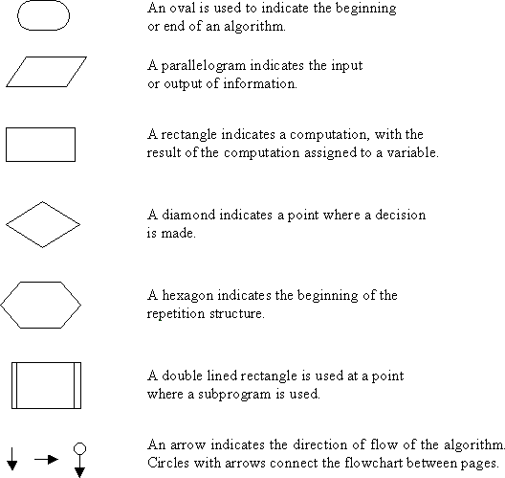
Flowchart:Symbols used to draw flowcharts:

Slide 48
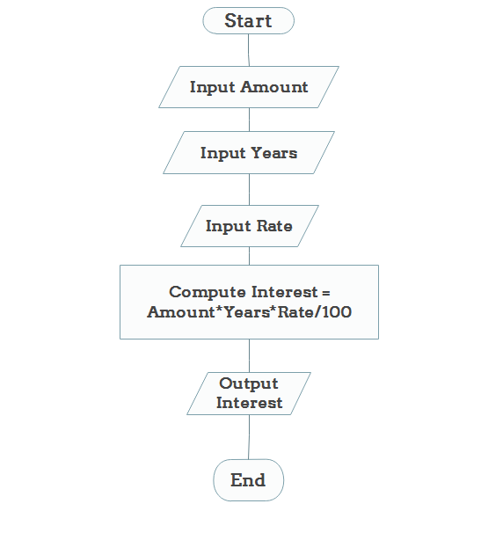
Flowchart
. Example 1: Calculate the Interest of a Bank Deposit

Slide 49
Flowchart
. Example 1: Calculate the Interest of a Bank Deposit
MORE_EXAMPLES

Slide 50
Problem Solving or Program Development Steps
Problem Solving is the process of solving a problem in a computer system by following a sequence of steps.
Defining the problem.
Designing the algorithm.
Coding the program.
Testing and debugging the program
Implementing the program.
Maintaining and updating the program.

Slide 51
Problem Solving or Program Development Steps
Problem Solving is the process of solving a problem in a computer system by following a sequence of steps.
Defining the problem.
Designing the algorithm.
Coding the program.
Testing and debugging the program
Implementing the program.
Maintaining and updating the program.

Slide 52
Types of errors or bugs
Three types of errors or bugs can be found which are
Syntax Error
Syntax is a set of rules by which a programming language is governed. Syntax error occurs when these rules are violated while coding of the program.
Logical Error
Improper coding of individual statements either or sequence of statements causes this type of computer program. It does not stop the program execution but gives wrong results.
Runtime Error
This error in a computer program stops its execution. It may be caused by an entry of invalid data.

Slide 53
UNIT-1
L3:
1.Introduction to C
2.Desirable Program characteristics
3.C Character Set
4.Identifiers
5. Keywords
6. Data Types

Slide 54
Introduction to C
C is high level language developed by Dennis Ritche at AT &T Bell Laboratories
Features of C
1. It is a robust language, whose rich set of built-in functions and operations can be used to write any complex program
2. It is a middle level language because the ‘C’ compiler combines the capabilities of an assembly language with the features of a high-level language and therefore it is well suited for writing both system software and business packages.
3. ‘C’ Programs are efficient and fast
4. C is highly portable, that is c programs written for one computer can be run on another with little (or) modification.
5. ‘C’ Language is well suited for structured programming,
54

Slide 55
Desirable Program Characteristics
Integrity
Refers to the accuracy of the computations
Clarity
Refers to the overall readability of the program
If a program is clearly written, it should be possible for another programmer to follow the program logic without undue effort.
Simplicity
The clarity and accuracy of a program are usually enhanced by keeping things as simple as possible, consistent with the overall program objectives
Computational efficiency would increase if the program structure must be simple, straightforward.
,
55

Slide 56
Desirable Program Characteristics
Efficiency
concerned with execution speed and efficient memory utilization.
Modularity
programs can be broken down into a series of identifiable subtasks
In C, such modules are written as functions.
The use of a modular programming structure enhances the accuracy and clarity of a program, and it facilitates future program alterations.
Generality
Program should be written in generalization fashion rather than static.
Ex. Assigning values to the operands as constants rather than dynamic values from the user.
,
56

Slide 57
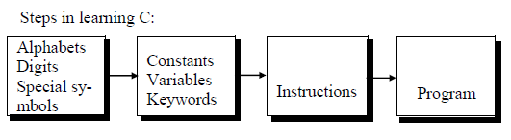
Introduction to C
To write C programs, we must know what alphabets, numbers and special symbols are used in C, then how using them constants, variables and keywords are constructed.
How are these combined to form an instruction.
A group of instructions would be combined later on to form a program.

Slide 58
KEYWORDS
The keywords are also called ‘Reserved words’.
Keywords are the words whose meaning has already been explained to the
C compiler and their meanings cannot be changed.
Keywords serve as basic building blocks for program statements.
Keywords can be used only for their intended purpose.
Keywords cannot be used as user-defined variables.
All keywords must be written in lowercase.
32 keywords available in C.
auto | double | int | struct
break | else | long | switch
case | enum | register | typedef
char | extern | return | union
const | float | short | unsigned
continue | for | signed | void
default | goto | sizeof | volatile
do | if | static | while

Slide 59
Examples :*/addition of 2 numbers*/
#include<stdio.h>
int main() {
int a, b, sum;//declaration by using of keywords//
printf("\nEnter two no: ");
scanf("%d %d", &a, &b);
sum = a + b;
printf("Sum : %d", sum);
return(0);

Slide 60
Identifier
An identifier is a string of alphanumeric characters.
It begins with an alphabetic character or an underscore character.
used to represent various programming elements such as variables, functions, arrays, structures, unions and so on.
Actually, an identifier is a user-defined word
Rules for constructing identifiers 1. The first character in an identifier must be an alphabet or an underscore and can be followed only by any number alphabets, or digits or underscores. 2. They must not begin with a digit. 3. Uppercase and lowercase letters are distinct. That is, identifiers are case sensitive.
60

Slide 61
Identifier in c program
#include<stdio.h>
Int main()
{ //c is case sensitive language//
Int ab=10;//valid
Int _ab=10;//valid
Int AB=10;//valid
Int ab1=20;//valid
int 1ab=10;//invalid
Int a b=20;//invalid
Int a_b=30;//valid
Printf(“value of ab is:%d”,ab);
Printf(“\n value of ab is:%d”,_ab);
Printf(“ \n value of ab is:%d”,AB);
Printf(“\n value of ab is:%d”,ab1);
Printf(“\n value of ab is:%d”,a_b);
}

Slide 62
What is a Variable?: name of the memory location A variable is an identifier which is used to store some value. Constants can never change at the time of execution. Variables can change during the execution of a program and update the value stored inside it. Syntax: declare a variable: type variable_list; examples: int a=10; float b=20.8; char c[7]=“cmrcet”;//collection of characters--string// char d[5]={‘h’,’I’};

Slide 63
Rules for defining varaibles:
Following are the examples of valid variable names in a 'C' program: height,HEIGHT my_name=“cmr”; _name;
Examples:
Int a;
Int _ab;
Int a30; For example, we declare an integer variable my_age and assign it the value 40: int my_age=40; float my_height=6;

Slide 64
Variable in c
here a,b,c are variables the in,float,char are the data types.
We can also provide values while declaring the variables as
given below
Int a=20,b=30;//declaring 2 variables of integer type//
Float f=20.6;
Char c=‘a’;

Slide 65
#include<stdio.h>
int main()
{
int a=10, b=20, sum;//1011
printf("\nEnter two no: ");
scanf("%d %d", &a, &b);
sum = a + b;
printf("Sum : %d", sum);
return 0;
}

Slide 66
Types of variables in c
Local variables:
a variable that is declared inside the function or block is called a local variable
It must be declared at the start of the block.
void function()
{
Int x=10;
Printf(“%d”,&x) //local variable*/ you must initialize the local variable before it is u
}

Slide 67
Global variable
A variable that is declared outside the function or block is called a gloabal variable.
any function can change the value of the variable.
it is available to all the function
It must be declared at the start of the block.
Int value=20;//global variable
Void function()
{
Int x;’//local
}

Slide 68
static variable
A variable that is declared with the static keyword is called static variable.
It retains its value between multiple function calls.
void function()
{
Int x=10//local
Static int y=10;//static variable
X=x+1;
Y=y+1;
Printf(“%d,%d”,x,y);
}
Note:
If you call this function many times the local will print the same value for
each function call,
eg:11,11,11 and so on
but the static variable will print the incremented value in each function call
eg:11,12,13,14 so on..

Slide 69
Automatic variables
All variables in c that are declared inside the block,are automatic variable by default.
we can clearly.
declare an automatic variable using auto keyword
Void main()
{
Int x=10;//local variable(also automatic)
Auto int y=20;//automatic variable

Slide 70
#include<stdio.h>
Main()
{
Auto int i=1;
{
Auto i=2;
{
Auto i=3;
Printf(“%d”,i);
}
Printf(“%d”,i);
}
Printf(“%d”,i);
}
Output:
3
2
1

Slide 71
Extern:is available through out the program they are declared the block.
Default value=zero.
#include<stdio.h>
Extern int i=1;//it is available through out program//
Main()
{
Int i=3;
Printf(“%d”,i);
Fun();
}
Fun()
{
Printf(“%d”,i);
}
Output:
3
1

Slide 72
external variable:
We can share a variable in multiple c source files by using an external variable.
Declare an external variable ,you need to use extern keyword.
Myfile.h
Extern int x=10;//external variable(also glabal)

Slide 73
Register variable:( smallstorage memory)—keyword--register
Reg variable values are strored in cpu reg rather than in memory
Reg are temporary storage units in cpu
They allow faster acess time for reg variables than normal var
Example:#include<stdio.h>
Main()
{
Register int I;
For(i=1;i<=5;i++)
{
Printf(“%d”,i);
}
}
Output:
1
2
3
4
5//this values store in register

Slide 74
Constants:
Constants: a constant is one (also identifier)whose value cannot be changed during
program execution.
In c language we can declare constates using “const” or “#define”
Also called “literals”
C constatns are divided into 2 categeries
1)numeric constants
2)character constants

Slide 75
Numeric constats-----
1)integer constants-----it accepts (positive negative values)only integer data type values.
2)real/floating point constants:are consts used to store point values(+ve /-ve)

Slide 76
Infix int constants:it indicates the base of the values in which it has to be read.
again divided into 4 types.
1)decimal int constats(base 10): {0 to 9} –acept +ve and -ve values.
But should not start with 0(zero).
Eg:123,-567,100
2)octal integer constant: (base is 8) ----{0 to 7}
---Must start with ‘0’zero
Eg: 0123,0456
3.hexadecimal constat : (base is16)—contain values from {0 to 9} and A to F (OR) a to f
But they start with 0x or 0X
Eg: 0x123, 0X146
4.binary integer constat :(base 2)
Only two values ‘0’ &’1’
Start with 0b or 0a eg: 0a1101,0b11011

Slide 77
Suffix int const: indicates the datatype in which that values has to read.
Eg:123(simply default int constnt)
123u----unsigned integer int
123l---long int const
123ul---unsigned long int

Slide 78
2)real/floating point constants:are consts used to store point values(+ve /-ve)
It has again divided 2 type:
Decimal form: it must contain a decimal part
Eg:3.134, -123.4
Exponential form: (no of fraction )we are represent
Eg:123e12

Slide 79
Character constats:
1)Single char constats: a character which has been specified with in single quotes it may be
eg:’a’,’2’,’&’(either may digit ,alphabet,symbol)
Char a[5]={‘c’,’m’,’r’};
2) String constats :
A group of characters which are enclosed between double quotes
Eg:”hello”,”4+10”, “hello world”(white spaces,digits,alphbets)
Backslash characters constats:which are excuted directly by compiler
Are having some specific meaning
Eg:\n---new line
\t---horigental tab
\a----audible alert(beep sound)
\0---null values

Slide 80
Examples:
#include<stdio.h>
Void main()
{
Const int a=100;
a=120;
Printf(“%d”,a);
}

Slide 81
Examples:
#include<stdio.h>
Void main()
{
Const char a[10]=”cmrcet”;//doesnot change the char//
Printf(“%d”,a);
}

Slide 82
Examples:
#include<stdio.h>
Void main()
{
Const float a=12.6;//doesnot change the float//
Printf(“%d”,a);
}

Slide 83
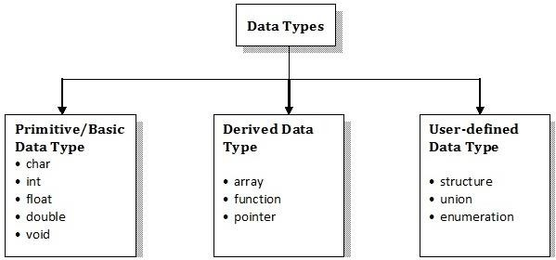
Data Types of C
C supports different types of data. The type or Data type refers a type of data that is going to be stored in variable. Data types can be broadly classified as shown in figure

Slide 84
Data types:
A data type specifies the type of data that a variable can store such as a integer
,floating,characters etc
Int a =1;
Data types in c:
Basic data types-----int,char,float,double
Derived data types---------array,pointer,structure,union
Enumeration d.type----------enum
Void data type--------void

Slide 85
Data types:
Char d.t:
Signed char---1byte (memory size)(range-128 to 127)//accepts +ve and –ve values//
Unsigned char----1bye(range 0 to 255)//accepts +ve values//
Char-1byte-8bites

Slide 86
Short d.types------(memory size --2bytes)
Signed short------(-32,768to32767)
2.unsigned short------(0 to 65,535)
Int------------(2bytes)
Signed int: -----(-32,768to32767)
unsigned int:-----(0 to 65,535)
Long int-------(4byte)
Signed int: -----(-2,147,483,648to 2,147,483,648)
unSigned int: -----(0 to 4,294,967,295)

Slide 87
Long----------------------------------4bytes(memory size)
Double--------------------------8bytes
Long double-----------------------------10bytes

Slide 88
Example: the sizeof operator is the most common operator in C. It is a compile-time unary operator and used to compute the size of its operand. It returns the size of a variable. It can be applied to any data type, float type, pointer type variables.
//sizeof() function in c langugue
#include <stdio.h>
Int main()
{
int a;
Char b;
Float c;
Double d;
printf(“storage size for int datatype is:%d\n’, sizeof(a));
printf(“storage size for char datatype is:%d\n”, sizeof(b));
printf(“storage size for float datatype is:%d’\n”, sizeof(c));
printf(“storage size for double datatype is:%d\n”, sizeof(d));
}
Output:
A=2
B=1
c=4
D=10

Slide 89
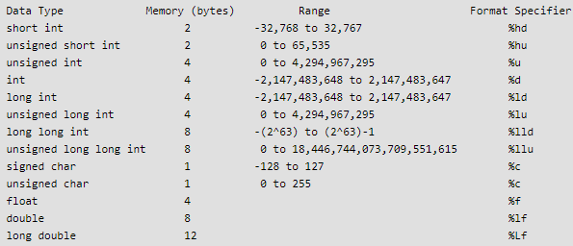
Data Types of C

Slide 90
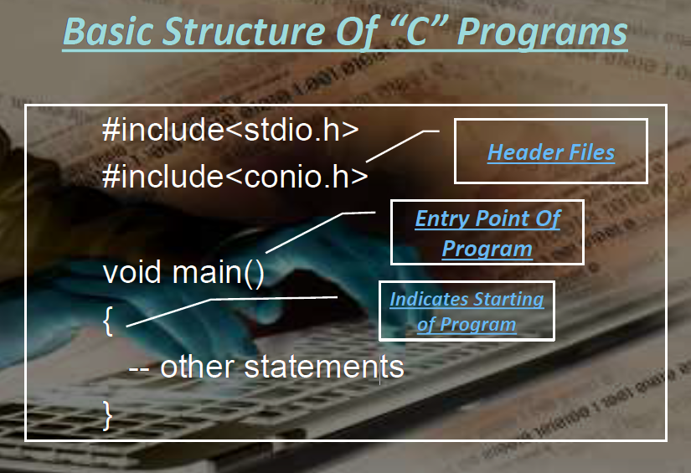
Sample C Program
90

Slide 91
Sample C Program
//C Sample Programs
#include <stdio.h>
int main()
{
printf("Hello World\n");
return 0;
}
Output: Hello World
91

Slide 92
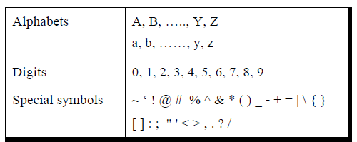
The C Character Set
There are two sets of characters in “C” language
Source characters.
Execution characters
Source Characters
These are characters that are used to create source text file. Source characters include
92

Slide 93
The C Character Set
Execution Characters
Escape sequence | Meaning | Result
\b | Backspace | Moves the cursor to the previous position of the current line.
\a | Bell(alert) | Produces a beep sound for alert
\r | Carriage return | Moves the cursor to beginning of the current line.
\n | New line | Moves the cursor to beginning of the next line.
\0 | Null | Null character
\v | Vertical tab | Moves the cursor to next vertical tab position.
\t | Horizontal tab | Moves the cursor to next horizontal tab position.
\\ | Backslash | Present a character with backslash(\)
93

Slide 94
Identifier
4. Commas or blank spaces are not allowed within an identifier.
5. Keywords cannot be used as an identifier.
6. Identifiers should not be of length more than 31 characters.
7. Identifiers must be meaningful, short, quickly and easily typed and easily read
Valid identifiers:
total sum average _x y_ mark_1 x1 Invalid identifiers 1x - begins with a digit char - reserved word x+y - special character

Slide 95
UNIT-1
L5:
1.Constants and Variables
2. Symbolic Constants
3.Variables and Arrays
4. Declarations
5. Expressions
6. Statements

Slide 96
Constants/literals
C Constants are also like normal variables.
Difference is, their values can not be modified by the program once they are defined.
Constants refer to fixed values.
They are also called as literals.
Constants may be belonging to any of the data type.
Syntax:
const data_type variable_name;
(or) const data_type *variable_name;
TYPES OF C CONSTANT:
Integer constants
Real or Floating point constants
Octal & Hexadecimal constants
Character constants
String constants
Backslash character constants

Slide 97
Constants/literals
#include <stdio.h>
void main()
{
const int height = 100; /*int constant*/
const float number = 3.14; /*Real constant*/
const char letter = 'A'; /*char constant*/
const char letter_sequence[10] = "ABC"; /*string constant*/
const char backslash_char = '\?'; /*special char cnst*/
Const int hex=0x40;
Const int oct=040;
printf("value of height :%d \n", height );
printf("value of number : %f \n", number );
printf("value of letter : %c \n", letter );
printf("value of letter_sequence : %s \n", letter_sequence);
printf("value of backslash_char : %c \n", backslash_char);
Printf(“%x”,hex);
Printf(“%o”,oct);
}

Slide 98
Symbolic Constants
A symbolic constant is name that substitute for a sequence of character that cannot be changed. The character may represent a numeric constant, a character constant, or a string.
When the program is compiled, each occurrence of a symbolic constant is replaced by its corresponding character sequence.
They are usually defined at the beginning of the program

Slide 99
Symbolic Constants
#include <stdio.h>
#define height 100
#define number 3.14
#define letter 'A'
#define letter_sequence "ABC"
#define backslash_char '\?'
void main()
{
printf("value of height : %d \n", height );
printf("value of number : %f \n", number );
printf("value of letter : %c \n", letter );
printf("value of letter_sequence : %s \n",letter_sequence);
printf("value of backslash_char : %c \n",backslash_char);
}

Slide 100
Variables Declaration
A variable is an identifier that is used to represent some
specified type of information within a designated portion
of the program. Syntax is <data type> <variable name>;
The data item must be assigned to the variable at some
point in the program.
The data item can then be accessed later in the program
simply by referring to the variable name.
Information represented by the variable can change during
the execution of the program. However, the data type
associated with the variable cannot change.

Slide 101
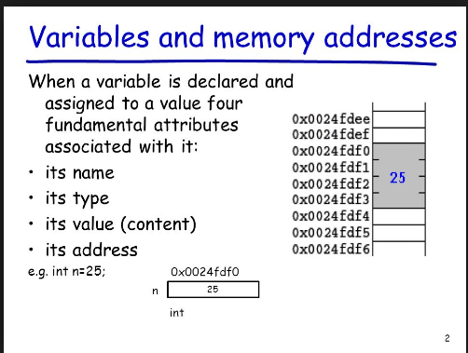
Variables Declarations

Slide 102
Variables Declarations
Each variable used must be declared.
A form of a declaration statement is
data-type var1, var2,…;
Declaration announces the data type of a variable and
allocates appropriate memory location.
No initial value (like 0 for integers) should be assumed.
It is possible to assign an initial value to a variable in
the declaration itself.
data-type var = expression;
Examples
int sum = 0;
char newLine = ‘\n’;
float epsilon = 1.0e-6;

Slide 103
Variables Declarations
Global Variables
These variables are declared outside
all functions.
Life time of a global variable is the
entire execution period of the program.
Can be accessed by any function
defined below the declaration, in a file.
/* Compute Area and Perimeter of a circle */
#include <stdio.h>
float pi = 3.14159; /* Global */
main() {
float rad; /* Local */
printf( “Enter the radius “ );
scanf(“%f” , &rad);
if ( rad > 0.0 ) {
float area = pi * rad * rad;
float peri = 2 * pi * rad;
printf( “Area = %f\n” , area );
printf( “Peri = %f\n” , peri );
}
else
printf( “Negative radius\n”);
printf( “Area = %f\n” , area );
}

Slide 104
Variables Declarations
Local Variables
These variables are declared inside some functions.
Life time of a local variable is the entire execution period of the
function in which it is defined .
Cannot be accessed by any other function.
In general variables declared inside a block are accessible
only in that block.

Slide 105
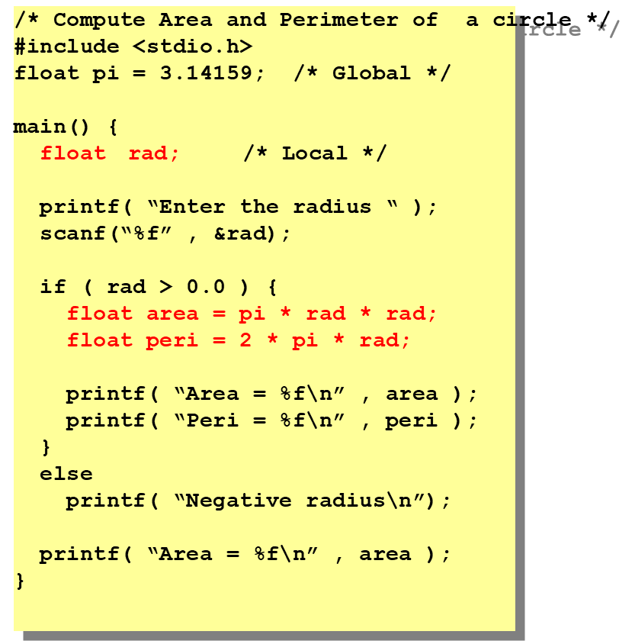

Slide 106
Variables & Array Declarations
Example:
int a, b, c;
char d;
....
.....
a = 3;
b = 5;
c=a+b;
d = ‘a’;
a = 4;
b = 2;
c=a-b;
d = 'W';
The array is another kind of variable that is used extensively in C.
An array is an identifier that refers to a collection of data items that all have the same name.
Ex:
int x[10];
x is a 10-element array.

Slide 107
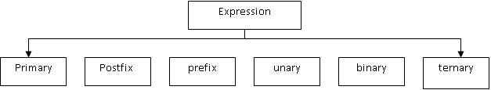
Expressions
An expression is a combination of operators and operands which reduces to a single value
An operand is a data item on which an operation is performed.
An operator indicates an operation to be performed on data
eg; z = 3+2*1 , z = 5 Types of Expressions
1. Primary expressions
The operand in the primary expression can be a name, a constant or any parenthesized expression
E.g: c = a+ (5*b);

Slide 108
Expressions
2. Postifix expressions:
The operator will be after the operands in a postfix expression
Eg:
a=5//z=a++ ===> z= a
a = a+1--
3. Prefix expressions
The operator is before the operand in a prefix expression.
Eg: z=++a ===> a = a+1
z= a
4. unary expression:
It contains one operator and one operand
Eg: a++, --b
5. Binary expression
It contains 2 operands and one operator
Eg: a=b, c*d
6. Ternary expression
It contains 3 operands and two operators
Eg ; Exp1? Exp2 :Exp3
If Exp1 is true ,Exp2 is executed. otherwise Exp3 is executed.
Demo_examples

Slide 109
Statements
A statement causes the computer to carry out some action.
There are three different classes of statements in C.
expression statements
compound statements
control statements.
An expression statements:
consists of an expression followed by a semicolon. The execution of an
expression statement causes the expression to be evaluated.
Ex:
Int a = 3;
Int c=a+b;
++a;
printf (“c = %d”, c);

Slide 110
Statements
2. An Compound statements:
A compound statement consists of several individual statements
enclosed within a pair of braces { }.
Ex:
{
pi = 3.141593;
circumference = 2. * pi * radius;
area = pi * radius * radius;
}

Slide 111
Statements
3. Control Statements:
Control statements are used to create special program features,
such as logical tests, loops and branches. Many control
statements require that other statements be embedded within
them, as illustrated in the following
example. Ex:
while (count <= n)
{
printf('x = ');
scanf ( "Skf" , &x) ;
sum += x; ++count;
}

Slide 112
UNIT-1
L6:
1.How to compile and execute C program
2. Error diagnostic and debugging techniques
3.Structure of C program
4.Writing a C program

Slide 113
CREATING AND RUNNING PROGRAM
There are 4 steps in this process.
1) Writing and editing the program
‘Text editors’ are used to write programs.
Users can enter, change and store character data using text editors
Special text editor is often included with a compiler
After completing writing program, the file is saved to disk. It is known as “source file’ .
This file is input to the compiler

Slide 114
CREATING AND RUNNING PROGRAM
2) Compiling the program
“Compiler” is a software that translates the source file into machine language(in the form of 0’s and 1’s). Saved with .obj extension
The ‘C’ compiler is actually 2 separate program
a) Preprocessor
b) Translator
A) Preprocessor
It reads the source code and prepares it for the translator
It scans for special instructions known as ‘preprocessor’ commands
These commands tell the preprocessor to look for special code libraries and make substitutions
The result of preprocessing is called ‘translation’ unit

Slide 115
CREATING AND RUNNING PROGRAM
3. Linking programs: The object file is not only enough to get the output. The object code of the keywords used in the program is needed to be combined with the object file. For example in any program, We use printf keyword and the object code of printf is needed to be combined with object file.
4. Program execution: Once the program has been linked, it is ready for execution. The program must be loaded in to the primary memory to execute it. Loader will load the program in to main memory. We use Run to execute the program.

Slide 116
Errors Diagnostics
C compilers will generate diagnostic messages when syntactic errors have been detected during the compilation process.
These diagnostic messages are not always straightforward in their meaning and they may not correctly identify where the error occurred.
The program contains five different syntactic errors.
1. The include statement does not begin with a # sign.
2. The control string in the printf statement does not have a closing quotation mark.
3. The last scanf statement does not end with a semicolon.
4. The assignment statement contains unbalanced parentheses.
5. The last comment closes improperly (it ends with / * instead of */).

Slide 117
Errors Diagnostics
Syntactic errors are relatively easy to find and correct, even if the resulting error messages are unclear.
Execution errors or logical errors, on the other hand, can be much more troublesome.
When an execution error occurs, we must first determine its location (where it occurs) within the program.
Once the location of the execution error has been identified, the source of the error (why it occurs) must be determined.
Fortunately, methods are available for finding the location of execution errors and logical errors within a program.
Such methods are generally referred to as debugging techniques.
Error Isolation
Tracing
Watch Values
Break points
Stepping

Slide 118
Debugging Techniques
Error Isolation:
Error isolation is useful for locating an error resulting in a diagnostic message.
If the general location of the error is not known, it can frequently be found by temporarily deleting a portion of the program and then rerunning the program to see if the error disappears.
The temporary deletion is accomplished by surrounding the instructions with comment markers (/* and */), causing the enclosed instructions to become comments.
If the error message then disappears, the deleted portion of the program contains the source of the error.
Tracing:
Tracing involves the use of printf statements to display the values assigned to certain key variables, or to display the values that are calculated internally at various locations within the program.
This information serves several purposes.
Watch Values:
A watch value is the value of a variable or an expression which is displayed continuously as the program executes.
Thus, you can see the changes in a watch value as they occur, in response to the program logic

Slide 119
Debugging Techniques
In Turbo C++, watch values can be defined by selecting Add Watch from the Debug menu and then specifying one or more variables or expressions in the resulting dialog box.
The watch values will then be displayed within a separate window as the program executes
Break Points:
A breakpoint is a temporary stopping point within a program. Each breakpoint is associated with a particular instruction within the program.
When the program is executed, the program execution will temporarily stop at the breakpoint, before the instruction is executed.
The execution may then be resumed, until the next breakpoint is encountered. Breakpoints are often used in conjunction with watch values, by observing the current watch value at each breakpoint as the program executes.
To set a breakpoint in Turbo C++, select Add Breakpoint from the Debug menu, and then provide the requested information in the resulting dialog box. Or, select a particular line within the program and designate it a breakpoint by pressing function key F5. The breakpoint may later be disabled by again pressing F5

Slide 120
Debugging Techniques
Stepping:
Stepping refers to the execution of one instruction at a time, typically by pressing a function key to execute each instruction
In Turbo C++, for example, stepping can be carried out by pressing either function key F7 or F8. (F8 steps over subordinate functions, whereas F7 steps through the functions.) By stepping through an entire program, you can determine which instructions produce erroneous results or generate error messages

Slide 121
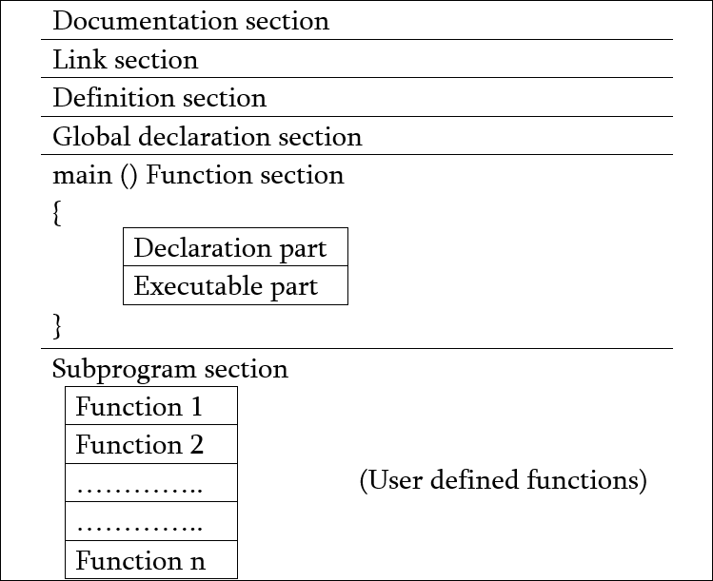
C Programs
Structure of a C Program:

Slide 122
C Programs
Documentation section
The documentation section consists of a set of comment lines giving the name of the program, the author and other details, which the programmer would like to use later. There are two types of comment lines.
1. Block comment lines /* */ and
2. Single line comment lines. //
Link section
The link section provides instructions to the compiler to link functions from the system library.
#include directive
The #include directive instructs the compiler to include the contents of the file "stdio.h" (standard input output header file) enclosed within angular brackets.
Definition section
The definition section defines all symbolic constants. #define PI 3.1413

Slide 123
C Programs
Global declaration section
There are some variables that are used in more than one function. Such variables are called global variables and are declared in the global declaration section that is outside of all the functions. This section also declares all the user-defined functions.
main() function section
Every C program must have one main function section. This section contains two
parts:
Declaration part and
Executable part

Slide 124
C Programs
Declaration part: It declares all the variables used in the executable part.
Executable part: There is at least one statement in the executable part.
These two parts must appear between the opening and closing braces. The program execution begins at the opening brace and ends at the closing brace. The closing brace of the main function is the logical end of the program. All statements in the declaration and executable part end with a semicolon.
Subprogram section
The subprogram section contains all the user-defined functions that are called in the main () function. User-defined functions are generally placed immediately after the main () function, although they may appear in any order.

Slide 125
C Programs
/* C Program - Get Input from User */
#include<stdio.h>
#include<conio.h>
void main()
{
clrscr();
char name[20];
int num;
printf("Enter a number : ");
scanf("%d",&num);
printf("You entered %d",num);
getch();
}

Slide 126
UNIT-1
L:7 ,8,9
1.Operators in C
Unary , Arithmetic , Logical, Relational ,
Bitwise,Conditional,Assignment,Secial
2. Precedence and Associativity of operators
3.Sample C programs on operators

Slide 127
Operators
An operator is a symbol which helps the user to give instruction to the
computer to do a certain mathematical or logical manipulations.
Operators are used in C language program to operate on data and variables.
Operators are special type of functions, that takes one or more arguments and produces a new value. For example : addition (+), substraction (-), multiplication (*) etc,
C has a rich set of operators which can be classified as follows:
1. Arithmetic operators.
2. Relational Operators.
3. Logical Operators.
4. Assignment Operators.
5. Increments and Decrement Operators.
6. Conditional Operators.
7. Bitwise Operators.
8. Special Operators.

Slide 128
Operators
Arithmetic Operators
All the basic arithmetic operations can be carried out in C.
All the operators have almost the same meaning as in other languages.
Both unary and binary operations are available in C language.
Unary operations operate on a singe operand,
Therefore the number 5 when operated by unary – will have the value –5.
Operator | example | Meaning
+ | a + b | Addition –unary
- | a – b | Subtraction- unary
* | a * b | Multiplication
/ | a / b | Division(Quotient)
% | a % b | Modulo division- remainder

Slide 129
Operators
1.Arithmetic Operators
Examples of arithmetic operators are: x + y , x - y , x * y , x / y , x % y
The modulus operator is a special operator in C language which evaluates the remainder of the operands after division.
Integer Arithmetic
When an arithmetic operation is performed on two integers than such an operation is called as integer arithmetic. It always gives an integer as the result. Let x = 27 and y = 5 x + y = 32 , x – y = 22 , x * y = 115 , x % y = 2 , x / y = 5
Floating point arithmetic
When an arithmetic operation is preformed on two real numbers such an operation is called floating point arithmetic.
Let x = 14.0 and y = 4.0 then x + y = 18.0 , x – y = 10.0 , x * y = 56.0 , x / y = 3.50
Mixed mode arithmetic
When one of the operand is real and other is an integer and if the arithmetic
operation is carried out on these 2 operands then it is called as mixed mode
arithmetic. If any one operand is of real type then the result will always be real t
15/10.0 = 1.5

Slide 130
Operators
/* Program to demonstrate the working of arithmetic operators in C. */
#include <stdio.h>
int main()
{
int a=9,b=4,c;
c=a+b;
printf("a+b=%d\n",c);
c=a-b;
printf("a-b=%d\n",c);
c=a*b;
printf("a*b=%d\n",c);
c=a/b;
printf("a/b=%d\n",c);
c=a%b;
printf("Remainder when a divided by b=%d\n",c);
return 0;
}

Slide 131
Operators
2.Relational Operators
Often it is required to compare the relationship between operands and bring out a decision and program accordingly. This is when the relational operator come into picture. C supports the following relational operators.
Operator | A=10,b=20 | output
< | A<b | 1
<= | A<=b | 1
> | A>b | 0
>= | A>=b | 0
== | A==b | 0
!= | A!=b | 1
Ex: It is required to compare the marks of 2 students, salary of 2 persons, we can compare them using relational operators.
(6.5 <= 25) , (-65 > 0) , (10 < 7 + 5)
which result in either TRUE OR FALSE
Relational expressions are used in decision making statements of C language such as if, while and for statements to decide the course of action of a running program
Program for relational operators u1_ex20.c

Slide 132
Algorithum: finding biggest of 2 numbers
Step 1: Start
Step 2: Read a, b . /* a, b two numbers */
Step 3: If a>b then /*Checking */
Display “a is the largest number”.
Otherwise
Display “b is the largest number”.
Step 4: Stop.
If( a>b)
{
---
--
}
Else
{

Slide 133
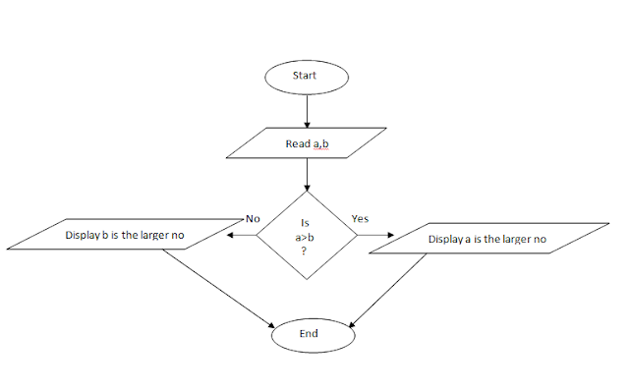
Flowchart: finding biggest numbers

Slide 134
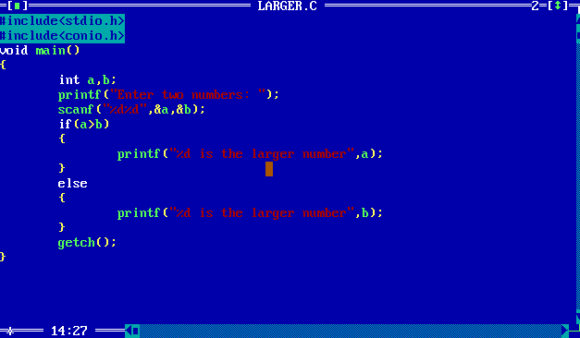

Slide 135
Operators
4. Assignment Operators
The Assignment Operator evaluates an expression on the right of the expression and substitutes it to the value or variable on the left of the expression.
Example: x = a + b
In addition, C has a set of shorthand assignment operators of the form.
var oper = exp;
Example: x + = 1 is same as x = x + 1
The commonly used shorthand assignment operators are as follows
Shorthand assignment operators
Statement with simple assignment operator | Statement with shorthand operator
a = a + 1 | a += 1
a = a – 1 | a -= 1
a = a * (n+1) | a *= (n+1)
a = a / (n+1) | a /= (n+1)
a = a % b | a %= b
Program for shorthand Assignment operators u1_ex22.c

Slide 136
//working of assignment operater
#include,stdio.h>
Main()
{
Int a=5,c;
C=a;
Printf(“c=%d\n”,c);
C+=a; //c=c+a
Printf(“c=%d\n”,c);
C-=a;
Printf(“c=%d\n”,c);
C*=a;
Printf(“c=%d\n”,c);
C/=a;
Printf(“c=%d\n”,c);
C%=a;
Printf(“c=%d\n”,c);
}
Output:
C=5
C=10
C=25
C=5
C=0

Slide 137
#Include<stdio.h>
main()
{
Int x=5;
X=x+3// x+=3;
Printf(“%d”, x);
}

Slide 138
Operators
5. Increment and Decrement Operators
The increment and decrement operators are one of the unary operators which are very useful in C language.
They are extensively used in for and while loops. The syntax of the operators is given below
1. ++ variable name 2. variable name++
3. – –variable name 4. variable name– –
The increment operator ++ adds the value 1 to the current value of operand.
The decrement operator – – subtracts the value 1 from the current value of operand.

Slide 139
Operators
5. Increment and Decrement Operators
++variable name and variable name++ mean the same thing when they form statements independently.
They behave differently when they are used in expression on the right hand side of an assignment statement.
Consider the following
m = 5;
y = ++m; //m=m+1=5+1=6(prefix) In this case the value of y and m would be 6
Suppose if we rewrite the above statement as
m = 5;
y = m++; (post fix) //y=5// m=m+1=6Then the value of y will be 5 and that of m will be 6.
Program for increment/ decrement operators u1_ex23.c

Slide 140
Example: m=5;
Y=++m; (prefix increment)
M=m+1//5+1=6;
Y=6;
Y value is 6
M value is 6
M=5;//y=m++(postfix increment)
Y=5
M=m+1//m=5+1=6; y value is 5
M value is 6
Prefix decrement y=--m // m=m-1
Postdcrement y=m-- // y=m //m=m-1

Slide 141
#include<stdio.h>
Int main()
{
Int m=5,y;
Y=++m ;// m=m+1//m=5+1=6 (or) y=m++; assign value first y=5//m=m+1//m=6
Printf(“%d\n”, y);
}
output: y=6
Y=5
Y= --m// m=m-1//
m=5-1=4;
y=4 (or) //y=5;y=m—
//y=5
m=5-1=4

Slide 142
#include<stdio.h>
Main()
{
int a=5;
A= ++a + ++a;// count how many pre increament operters//
Printf(“a%d”,a)
}
a value first store 5 in memoery location after that
Increment valu ++a//5+1=6 again//++a//6+1=7
A value is 7
7+7=14
Output is A=14

Slide 143
Operators
3. Logical Operators
C has the following logical operators; they compare or evaluate logical and
relational expressions.
Nonzero | Nonzero | 1 | 1
Nonzero | 0 | 0 | 1
0 | Nonzero | 0 | 1
0 | 0 | 0 | 0
&& | Logical AND
|| | Logical OR
! | Logical NOT
Logical AND (&&)
If both the expressions are true then the whole compound expression is true. Example: a > b && x = = 10
Logical OR (||)
If any one of the 2 expressions is true.
Example: a < m || a < n
Logical NOT (!)
The logical not operator evaluates to true if the expression is false and evaluates to false if the expression is true.
For example: ! (x >= y)
Program for logical operators u1_ex21.c

Slide 144
EXP1 EXP2 EXP1&&EXP2
True T rue True
True False False
F F F
F T F
EXP1 EXP2 EXP1||EXP2
T T T
T F T
F T T
F F F
EXP1 !not
T F
F T

Slide 145
#include<stdio.h>
Main()
{
Int a=5;b=10;
if (a>b && a<b)
{
Printf(“1st condition is true”);
}
Else
{
Printf(“1st condition is false”);
}
if( (a>b||a<b)
{
Printf(“2nd condition is true”);
}
Else
{
Printf(“2nd condition is false”);
}
If(!a) //a=5
{
Printf(“3rd condition is true”);
}
Else
{
Printf(“3rd condition is false”);
}
If(!b) //b=10
{
Printf(“4th condition is true”);
Else
{
Printf(“4th condition is false”);
}

Slide 146
Operators
6. Conditional or Ternary Operator
The conditional operator consists of 2 symbols the question mark (?) and the colon (:). The syntax for a ternary operator is as follows:
exp1 ? exp2 : exp3
The ternary operator works as exp1 is evaluated first. If the expression is true then exp2 is evaluated & its value becomes the value of the expression. If exp1 is false,exp3 is evaluated and its value becomes the value of the expression. Note that only one of the expression is evaluated.
For example:
a = 10;
b = 15;
x = (a > b) ? a : b
Here x will be assigned to the value of b.
The condition follows that the expression is false therefore b is assigned to x.
Output
Input 2 integers : 45 34
The largest of two numbers is 45
Program for conditional operators u1_ex24.c

Slide 147
#include<stdio.h>
Main()
{
X=300;
y=200, m;
Printf(“%d ,m=(x>y)? X: y;);
}
(or)
If(x>y)
{
M=x;
}
Else
{
M=y;
}
Output:
x=300

Slide 148
Operators
7. Bitwise Operators
The C language is well suited to system programming because it
contains operators that can manipulate data at the bit level.
Those operators are used for testing, complementing or shifting bits
to the right on left.
C has two categories of bitwise operators that operate on data at the
bit level:
1. Logical bitwise operators and
2. Shift bitwise operators.
Logical bitwise operators:
Operator | Meaning
& | Bitwise AND
| | Bitwise OR
^(xor) | Bitwise Exclusive OR
<< | Shift left
>> | Shift right

Slide 149
Operators
7. Bitwise Operators Truth table
~a | a^b | a|b | a&b | b | a
1 | 0 | 0 | 0 | 0 | 0
1 | 1 | 1 | 0 | 1 | 0
0 | 1 | 1 | 0 | 0 | 1
0 | 0 | 1 | 1 | 1 | 1
Program for bitwise operators u1_ex25.c

Slide 150
Operators
7. Bitwise Shift Operators
The shift operators moves bits to the right or left.
Bitwise shift-right operator:
The bitwise shift right (>>) is a binary operator that requires two integral operands .
The first operand is the value to be shifted.
The second operand specifies the number of bits to be shifted.
Ex: a >>= 5; /* shift right 5 bits */
For unsigned data type, bits positions vacated
by shift are filled with zeros.

Slide 151
Operators
7. Bitwise Right-Shift Operators
When we shift a binary numbers, the right-shift operator divides by a
power of 2.
If we shift a binary number two places to the right, we are dividing by 4.
If we shift it three places , we are dividing by 8.
2 shift value | Divide by | Shift Operator
1 | 2 | >>1
2 | 4 | >>2
3 | 8 | >>3
4 | 16 | >>4
….. | ……. | ……
n | 2n | >>n

Slide 152
Operators
7. Bitwise Left-Shift Operators
The bitwise shift right (<<) is a binary operator that requires two
integral operands .
The first operand is the value to be shifted.
The second operand specifies the number of bits to be shifted.
Ex: a <<=3; /* shift right 5 bits */
Bits positions vacated by shift are filled with zeros

Slide 153
Operators
7. Bitwise Left-Shift Operators
When we shift a binary numbers, the Left-shift operator multiplies by a
power of 2.
If we shift a binary number two places to the left, we are multiplying by 4.
If we shift it three places , we are multiplying by 8.
2 shift value | Multiplies by | Shift Operator
1 | 2 | <<1
2 | 4 | <<2
3 | 8 | <<3
4 | 16 | <<4
…. | …….. | ……
n | 2n | <<n
Program for bitwise shift operators u1_ex26.c

Slide 154
Operators
8. Special Operators
C supports some special operators of interest such as comma operator, size of
operator, pointer operators (& and *) and member selection operators (. and ->).
The size of and the comma operators are discussed here.
The Comma Operator
The comma operator can be used to link related expressions together. A comma linked list of expressions are evaluated left to right and value of right most expression is the value of the combined expression.
For example the statement
value = (x = 10, y = 5, x + y);
First assigns 10 to x and 5 to y and finally assigns 15 to value. Since comma has
the lowest precedence in operators the parenthesis is necessary. Some examples of comma operator are In for loops:
for (n=1, m=10, n <=m; n++,m++)
In while loops While (c=getchar(), c != ‘10’)
Exchanging values t = x, x = y, y = t; .
Program for comma operators u1_ex27.c

Slide 155
Operators
8. Special Operators
The size of Operator
The operator size of gives the size of the data type or variable in terms of bytes occupied in the memory. The operand may be a variable, a constant or a data type qualifier.
Example
m = sizeof (sum);
n = sizeof (long int);
k = sizeof (235L);
The size of operator is normally used to determine the lengths of arrays and structures when their sizes are not known to the programmer. It is also used to allocate memory space dynamically to variables during the execution of the program
Program for sizeof operators u1_ex28.c

Slide 156
Precedence and Associativity
Precedence
Precedence is used to determine the order in which different operators in a complex expression are evaluated .
C extents the concept to 15 levels.
Ex: 2+3*4=(2+(3*4))=14
-b++=(-(b++))
Associativity
Associativity is used to determine the order in which operators with the same precedence are evaluated in a complex expression.
Precedence is applied before associativity to determine the order in which expressions are evaluated.
Associativity can be left-to-right or right-to-left.
Program for precedence of operators u1_ex34.c

Slide 157
Precedence and Associativity
Left to Right Associativity
All the operators have the same precedence. Their associativity is from left to right. so they are grouped as follows
Ex: 3* 8 / 4 % 4 * 5
Right to Left Associativity
All the operators have the same precedence. Their associativity is from right to left. so they are grouped as follows
Ex: a += b *= c -= 5 which is (a=a+(b=b*(c=c-5)))
Program for Assocoativity of operators u1_ex35.c

Slide 158
Precedence and Associativity
Operator | Description | Precedence | Associativity
( ) [ ] . -> ++ -- | Parentheses (function call) Brackets (array subscript) Member selection via object name Member selection via pointer Postfix increment/decrement | 1 | left-to-right
++ -- + - ! ~ (type) * & sizeof | Prefix increment/decrement Unary plus/minus Logical negation/bitwise complement Cast (convert value to temporary value of type) Dereference Address (of operand) Determine size in bytes on this implementation | 2 | right-to-left
* / % | Multiplication/division/modulus | 3 | left-to-right
+ - | Addition/subtraction | 4 | left-to-right
<< >> | Bitwise shift left, Bitwise shift right | 5 | left-to-right

Slide 159
Precedence and Associativity
Operator | Description | Precedence | Associativity
< <= > >= | Relational less than/less than or equal to Relational greater than/greater than or equal to | 6 | left-to-right
== != | Relational is equal to/is not equal to | 7 | left-to-right
& | Bitwise AND | 8 | left-to-right
^ | Bitwise exclusive OR | 9 | left-to-right
| | Bitwise inclusive OR | 10 | left-to-right
&& | Logical AND | 11 | left-to-right
| | | Logical OR | 12 | left-to-right
? : | Ternary conditional | 13 | right-to-left
= += -= *= /= %= &= ^= |= <<= >>= | Assignment Addition/subtraction assignment Multiplication/division assignment Modulus/bitwise AND assignment Bitwise exclusive/inclusive OR assignment Bitwise shift left/right assignment | 14 | right-to-left
, | Comma (separate expressions) | 15 | left-to-right

Slide 160
Expression Evaluation
Now we evaluate expressions as we know precedence, associativity of operators
Expressions without side effects
Ex: a*4+b/2-c*b consider a=3 b=4 c=5
Replace variables by their values
3 * 4 + 4 / 2 – 5 * 4
Apply precedence rules
(3 * 4) + (4 / 2) – (5 * 4)
Apply Associativity rules as they are left to right associative
(((3 * 4) + (4 / 2)) – (5 * 4))
In evaluation of this expressions there are no side effects

Slide 161
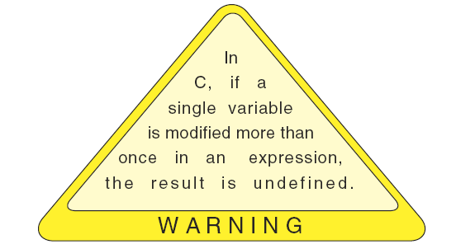
Expression Evaluation (2 of 2)
Expressions with side effects
Now look for example with side effects and parenthesized expressions.
Ex: --a * ( 3 + b ) / 2 – c++ * b
Assume a=3 b=4 c=5
Calculate the value of parenthesized expressions
--a * 7 / 2 – c++ * b
Evaluate postfix expression
--a * 7 / 2 – 5 * b
Evaluate prefix expression
2 * 7 / 2 – 5 * b
Now apply multiply and division
14 / 2 – 5*4
Last step is to evaluate subtraction
7-20=-13
After the side effects the variables
have the values shown below
a=2 b=4 c=6
Warning

Slide 162
UNIT-1
L-10,11
Data Input and Output
1. Formatted statements
2. Unformatted statements
3. Input / Output statements to
read and write Character, Integer and Real.

Slide 163
Data Input and Output
Input : In any programming language input means to feed some data into program.
Output : In any programming language output means to display some data on screen
Types of I/O Statements
Formatted I/O
scanf()
printf()
Unformatted I/O
gets(), puts()
getch(), getche(), putch()
getchar(), putchar()

Slide 164
Classification of Formatted &Unformatted statements
Formatted Functions
Type | Input | Output
int | scanf() | printf()
float | scanf() | printf()
char | scanf() | printf()
string | scanf() | printf()
Unformatted Functions
Type | Input | Output
int
float
char | getchar() | putchar()
string | gets() | puts()

Slide 165
Data Input and Output
a) printf ( ) function:
Syntax:
printf(“format string”, print list);
e.g.: printf (“average of 3 numbers = %f”,avg);
b) scanf ( ) function:
Syntax:
scanf (“format string”, input list);
e.g.: scanf (“%d %f”, &a, &b);

Slide 166
Printf() function
format control string
that describes the output format.
The format control string consists of conversion
Specifiers, flags, field widths, precisions and literal
characters. Together with the percent sign (%),
these form conversion specifications.
Rounding floating-point values to an indicated
number of decimal places.Right justification and
left justification of outputs. Inserting literal characters
at precise locations in a line of output. Representing
floating-point numbers in exponential format.
Representing unsigned integers in octal and
hexadecimal format.

Slide 167
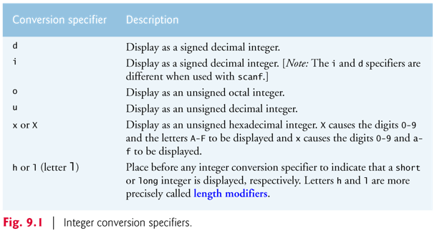
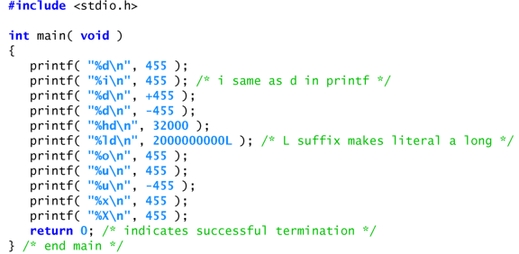
Printf() function contd..
Printing Integers:

Slide 168
Printf() function contd..
Printing Floating point numbers:
Format string | Meaning | example
%f | prints at least one digit to the left of the decimal point show six digits of precision to the right of the decimal point by default | 1.04592
%e or %E | conversion specifiers cause the value to be rounded in the output | 1234567.89 as 1.234568 e+006 1234567.89 as 1.234568 E+006
%g or %G | Trailing zeros are not printed in the fractional part of a value output with g or G. The difference between g and G is identical to the difference between e and E when the value is printed in exponential notation—lowercase g causes a lowercase e to be output, and uppercase G causes an uppercase E to be output | 0.0000875 as 8.75e-05 8750000.0 as 75e+06 1234567.0 as 1.23457E+06
NOTE: all floating-point conversion specifiers have a default precision of 6

Slide 169
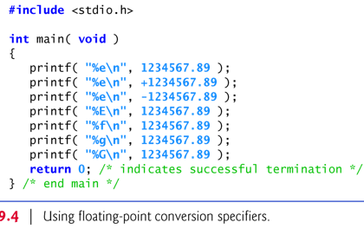
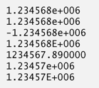
Printf() function contd..
Printing Floating point numbers:
Output:

Slide 170
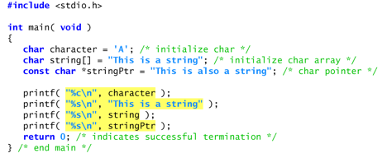
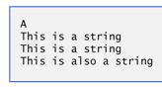
Printing character and strings
The c and s conversion specifiers are used
to print individual characters and strings,
respectively.
Conversion specifier s causes characters
to be printed until a terminating null ('\0')
character is encountered.

Slide 171
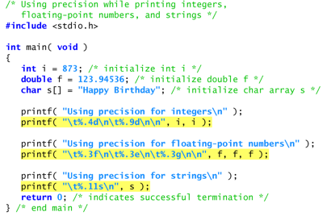
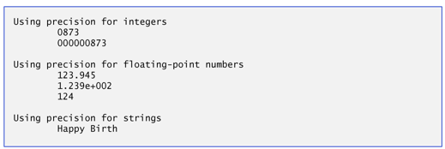
Printing Field widths & precision
Function printf() also enables you to
specify the precision with which data is printed.
Precision has different meanings for
different data types.
When used with integer conversion
specifiers, precision indicates the
minimum number of digits to be printed.
If the printed value contains fewer digits
than the specified precision and the
precision value has a leading zero or
decimal point, zeros are prefixed to the
printed value until the total number of
digits is equivalent to the precision.
The default precision for integers is 1.
Ex:
Output:

Slide 172
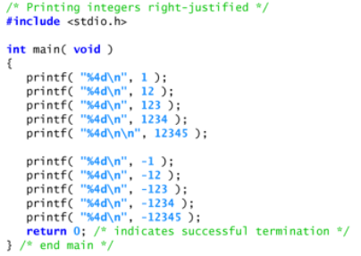
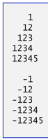
printing Field widths & precision
The exact size of a field in
which data is printed is specified
by a field width.
If the field width is larger than
the data being printed, the
data will normally be
right justified within that field.
An integer representing the field
width is inserted between the
percent sign (%) and the
conversion specifier (e.g., %4d).
Ex:

Slide 173
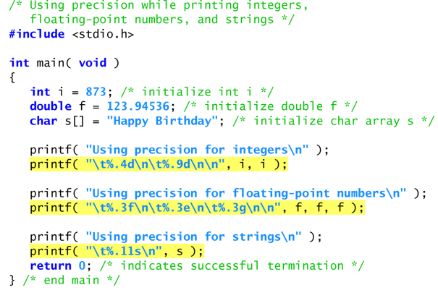
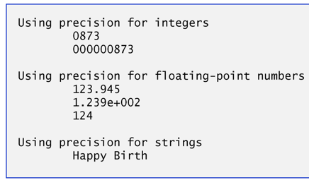
Printing Field widths & precision
Output:

Slide 174
Right and Left Justification Values
Output:

Slide 175


Reading Formatted Input with scanf()

Slide 176


Reading Formatted Input with scanf() contd.

Slide 177


Reading Formatted Input with scanf() contd.

Slide 178


Reading Formatted Input with scanf() contd.

Slide 179


Reading Formatted Input with scanf() contd.

Slide 180


Reading Formatted Input with scanf() contd.

Slide 181
Unformatted Input & Output
1. gets function(gets()) This special function is used to input string
values from the user during execution of the program.
As the user press enter key when typing after the string.
A null character (\0) is automatically entered at the end
of the string.
Syntax:
gets(variable name);
2. puts function
The function used to display the string value on the screen.
Syntax: puts(parameter/value/variable);

Slide 182
Unformatted Input & Output
iii)getch():getch() is used to get a character from console but does not echo to the screen. It reads a single character directly from the keyboard, without echoing to the screen.
Syntax
char ch;
ch = getch();
iv)getchar():It returns a single character from a standard input device (typically a keyboard).
Syntax
character variable = getchar( );

Slide 183
Unformatted Input & Output
(vii) putchar()
The putchar function like getchar is a part of the
standard C input/output library. It transmits a single
character to the standard output device
(the computer screen).
Syntax
putchar(character variable)

Slide 184

getchar() and putchar()
#include<stdio.h>
#include<ctype.h>
int main()
{
int lower, upper;
printf("enter a character");
lower=getchar();
upper=toupper(lower);
putchar(upper);
}

Slide 185

gets() and puts()
#include<stdio.h>
int main()
{
char stu_name[10];
printf("enter a student name\n\n");
gets(stu_name);
puts(stu_name);
}

Slide 186
Getch(): it is used to input a single character.it will read the character and doesnot
require enter key to be pressed.
Char ch;
Ch= getch();// ch=getchar();
Getchar():-- it is used to input a single character. Require enter key to be pressed.

Slide 187
Array:
An array is defined as the collection of similar type of data items stored
at contiguous memory locations. Arrays are the derived data type in
C programming language which can store the primitive type of data such
as int, char, double,float etc.

Slide 188

Example:
To store roll no. of 100 students, we have to declare an array of size 100 i.e roll_no[100]. Here size of the array is 100 ,
so it is capable of storing 100 values. In C, index or subscript starts from 0, so roll_no[0] is the first element, roll_no[1] I
s the second element and so on. Note that the last element of the array will be at roll_no[99] not at roll_no[100]
because the index starts at 0.

Slide 189

One-dimensional array
Conceptually you can think of a one-dimensional array as a row,
where elements are stored one after another.

Slide 190
Syntax: datatype array_name[size];
datatype: It denotes the type of the elements in the array.
array_name: Name of the array. It must be a valid identifier.
size: Number of elements an array can hold. here are some example of array declarations:

Slide 191
int num[100];
float temp[20];
char ch[50];
num is an array of type int, which can only store 100 elements of type int. temp is an array of type float, which can only store 20 elements of type float. ch is an array of type char, which can only store 50 elements of type char.

Slide 192
Example:1-D array
#include<stdio.h>
main()
{
int a[5]; //declaration of an arry namely a
int i;
for(i=0; i<=4; i++)//store the numbers from 0 to 4 in array=a
{
a[i]=i;
}
for(i=0;i<=4;i++)//disply the content of an array
{
printf("a[%d]=%d\n",i,a[i]);
}
}

Slide 193


Slide 194

#include<stdio.h> main() { int a[5]={1,2,3,4,5}; printf("the elements array are stored in continues" "memory location \n\n"); printf("a[0] address is %u\n",&a[0]); printf("a[1] address is %u\n",&a[1]); printf("a[2] address is %u\n",&a[2]); printf("a[3] address is %u\n",&a[3]); printf("a[4] address is %u\n",&a[4]); }

